Slide 1


Chapter 5: Kubernetes for Continuous Integration
Agile Brains Consulting
1
©Agile Brains Consulting Inc. All rights reserved. Not to be reproduced without prior written consent.

Slide 2
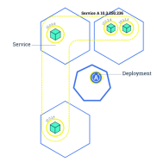
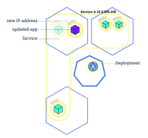
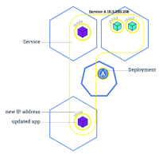
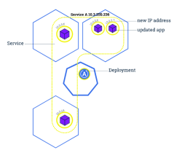
Kubernetes: Rolling Update
Updates the pods in a serial manner will load balancing traffic to available instances
If deployment is exposed publicly, the service will load-balance traffic to only active and available pods
Used to enable zero downtime updates
Allows greater application update frequency
Can also be leveraged to rollback to previous versions
Agile Brains Consulting
2
©Agile Brains Consulting Inc. All rights reserved. Not to be reproduced without prior written consent.

Slide 3
Zero Downtime Rolling updates and rollback
Agile Brains Consulting
3
©Agile Brains Consulting Inc. All rights reserved. Not to be reproduced without prior written consent.

Slide 4
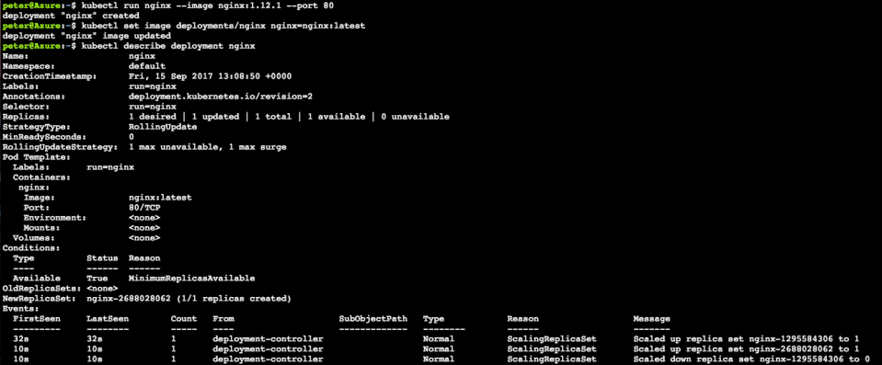
$ kubectl set image <deployment> <new-image>
Note: Rolling updates can also be undone (see next slide)
Agile Brains Consulting
4
©Agile Brains Consulting Inc. All rights reserved. Not to be reproduced without prior written consent.
Notes:
Stand up nginx but with an older version, 1.12.1
1. kubectl run nginx --image nginx:1.12.1 --port 80
Set image to the newer version (latest). This triggers kubernetes to begin a rolling update
2. kubectl set image deployments/nginx nginx=nginx:latest
Observe the newer image has been rolled out
3. kubectl describe deployment nginx

Slide 5
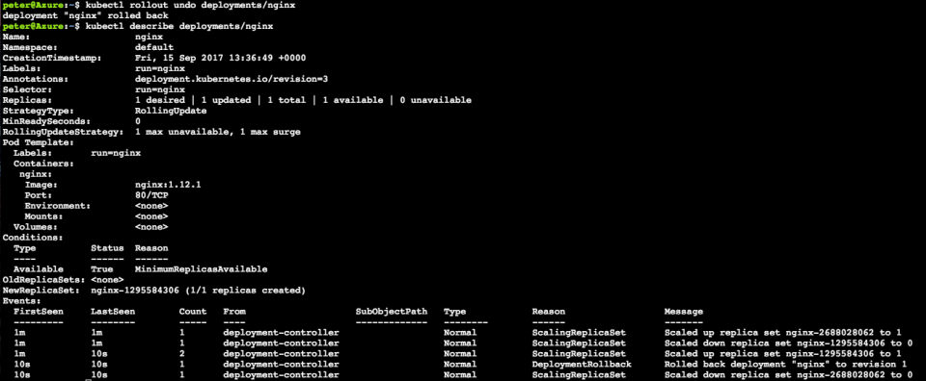
$ kubectl rollout undo <deployment>
Note: Rollbacks can also be also enacted with zero-downtime
Agile Brains Consulting
5
©Agile Brains Consulting Inc. All rights reserved. Not to be reproduced without prior written consent.
Notes:
Roll back to previous version nginx 1.12.1
4. kubectl rollout undo deployments/nginx
Observe changes
5. kubectl describe deployments/nginx

Slide 6
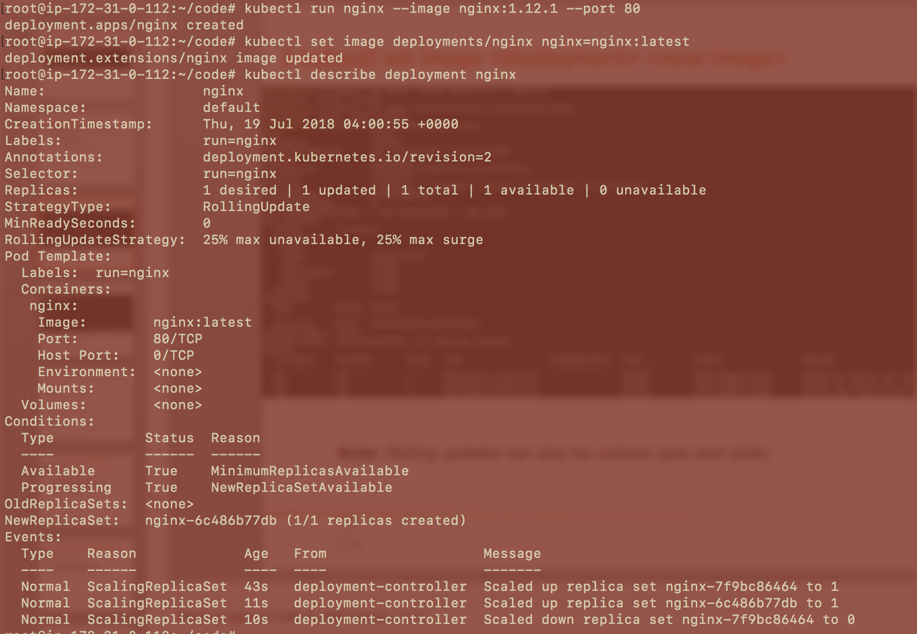
Agile Brains Consulting
6
©Agile Brains Consulting Inc. All rights reserved. Not to be reproduced without prior written consent.
Notes:
Stand up nginx but with an older version, 1.12.1:
1. kubectl run nginx --image nginx:1.12.1 --port 80
Set image to the newer version (latest). This triggers kubernetes to begin a rolling update:
2. kubectl set image deployments/nginx nginx=nginx:latest
Observe the newer image has been rolled out:
3. kubectl describe deployment nginx

Slide 7
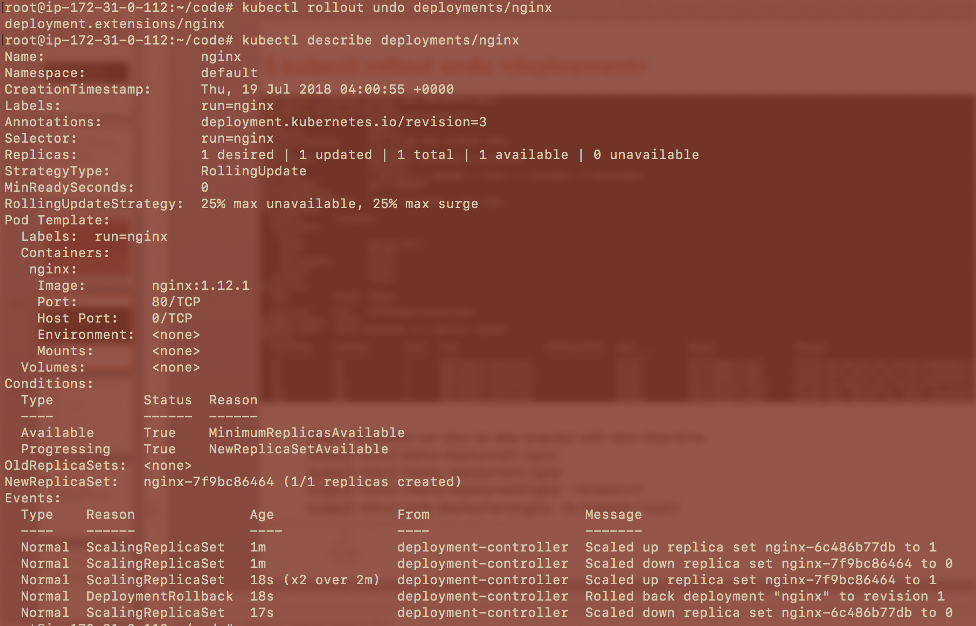
Note: Rollbacks can also be also enacted with zero-downtime
kubectl rollout status deployment nginx
kubectl rollout history deployment nginx
kubectl rollout history deployment/nginx --revision=3
kubectl rollout undo deployment/nginx --to-revision <num>
Agile Brains Consulting
7
©Agile Brains Consulting Inc. All rights reserved. Not to be reproduced without prior written consent.
Notes:
Roll back to previous version nginx 1.12.1
4. kubectl rollout undo deployments/nginx
Observe changes
5. kubectl describe deployments/nginx

Slide 8
Zero Downtime Scaling
Agile Brains Consulting
8
©Agile Brains Consulting Inc. All rights reserved. Not to be reproduced without prior written consent.

Slide 9
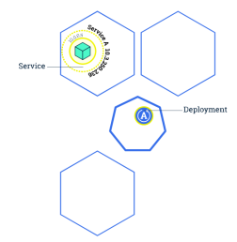
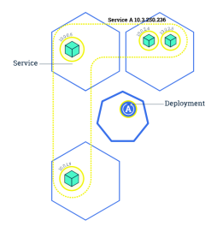
Kubernetes: Scaling
Changing the number of resources to meet a desired state
Accomplished by adjusting the number of replicas in a deployment
Accommodates both scaling up and scaling down to a minimum of 0
Traffic is automatically sent to newly created instances through the service load balancer
Can be used to enable rolling updates without downtime
Agile Brains Consulting
9
©Agile Brains Consulting Inc. All rights reserved. Not to be reproduced without prior written consent.

Slide 10
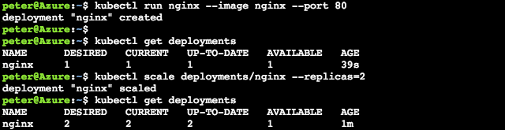
$ kubectl scale deployments/<deployment> --replicas=<new num>
$ kubectl scale deploy/nginx --replicas=4
Note: Make sure to delete the deployments or replicasets when trying to clear out pods. Many a new user has repeated deleted pods and gotten frustrated when they respawn (as the deployments/replicasets are programed to do).
Agile Brains Consulting
10
©Agile Brains Consulting Inc. All rights reserved. Not to be reproduced without prior written consent.
Notes:
kubectl run nginx –image nginx –port 80
kubectl get deployments
kubectl scale deployments/nginx –replicas=2
kubectl get deployments
http://kubernetesbyexample.com/labels/

Slide 11
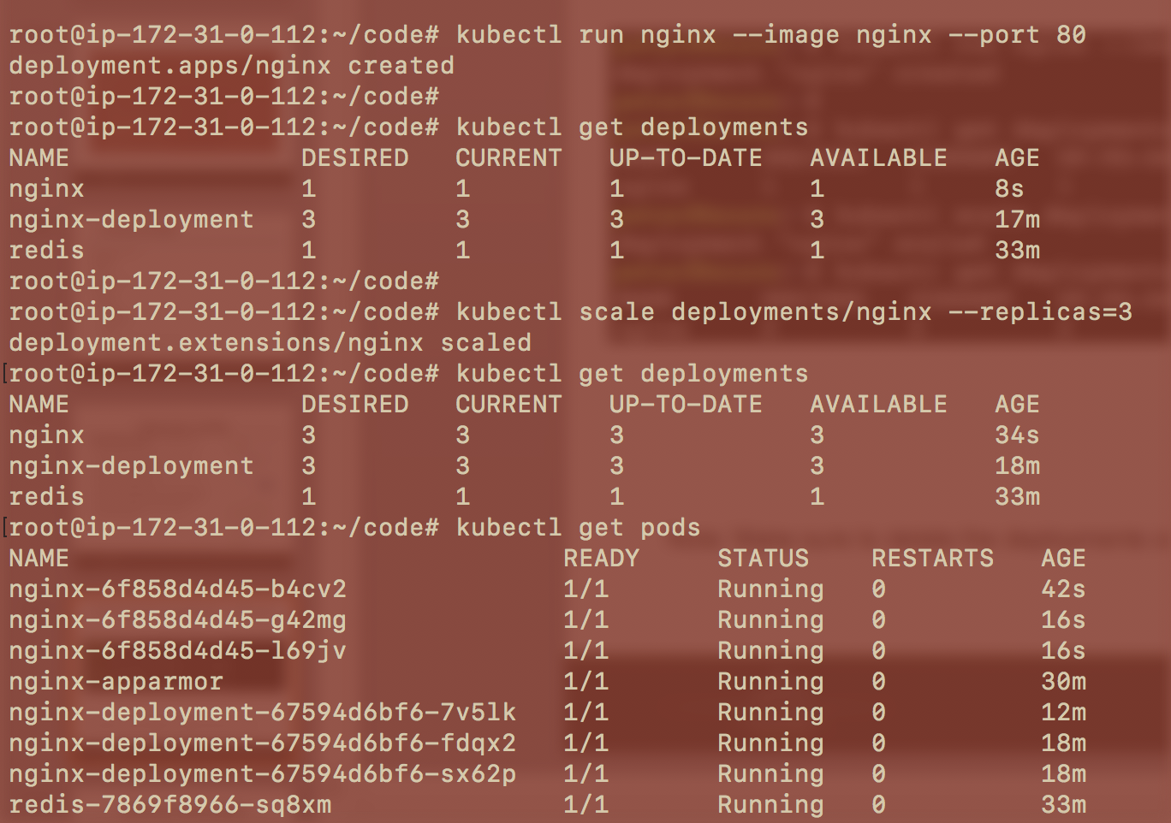
Agile Brains Consulting
11
©Agile Brains Consulting Inc. All rights reserved. Not to be reproduced without prior written consent.
Notes:
kubectl run nginx –image nginx –port 80
kubectl get deployments
kubectl scale deployments/nginx –replicas=2
kubectl get deployments
http://kubernetesbyexample.com/labels/

Slide 12
Autoscaling and HPA (Horizontal Pod Autoscaler)
Agile Brains Consulting
12
©Agile Brains Consulting Inc. All rights reserved. Not to be reproduced without prior written consent.

Slide 13
Kubernetes: AutoScaling
HPA – Horizontal Pod Autoscaler:
Based on memory and CPU utilization by a pod, autoscaling scales up or down the number of pods
$ kubectl autoscale deployment nginx --min=2 --max=10
$ kubectl autoscale deployment nginx-deployment --max=5 --cpu-percent=80
$ kubectl get hpa
$ kubectl get hpa
NAME REFERENCE TARGETS MINPODS MAXPODS REPLICAS AGE
nginx Deployment/nginx <unknown>/80% 1 4 3 12m
nginx-deployment Deployment/nginx-deployment <unknown>/80% 2 5 0 5s
Agile Brains Consulting
13
©Agile Brains Consulting Inc. All rights reserved. Not to be reproduced without prior written consent.

Slide 14
Exercise 4 – (scaling, Auto scaling, rollout)
For a previously created deployment scale the number of replicas
see the difference in replicasets, pods , and see with a describe
Rolling update, undo and see the changes in replica sets
cd to the ex4
https://github.com/shekhar2010us/kubernetes_teach_git/blob/master/ex4/scaling_rolling.md
Agile Brains Consulting
14
©Agile Brains Consulting Inc. All rights reserved. Not to be reproduced without prior written consent.

Slide 15
Deployment Strategies
Recreate
Version A is terminated then version B is rolled out
Ramped (Similar to Rolling Updates)
Version B is slowly rolled out and replacing version A
Blue - Green Deployment
Version B is released alongside version A, then the traffic is switched to version B
Canary Deployment
Version B is released to a subset of users, then proceed to a full roll-out
A/B Testing
Version B is released to a subset of users under specific condition
Shadow Deployments
Version B receives real-world traffic alongside version A and doesn’t impact the response
Agile Brains Consulting
15
©Agile Brains Consulting Inc. All rights reserved. Not to be reproduced without prior written consent.

Slide 16
Service Discovery
Agile Brains Consulting
16
©Agile Brains Consulting Inc. All rights reserved. Not to be reproduced without prior written consent.
Notes:
https://fredjean.net/kubernetes-discovery/

Slide 17
Service Discovery
Migrating from a monolithic architecture to a Microservices based architecture where each service loosely coupled and horizontally scaled will require a service discovery mechanism to ensure that the REST API endpoints of the ephemeral services (say, docker containers running inside PODs) are resolved or detected. The IP addresses of the containers (or the PODs) being transient will need automated mechanism to resolve or convey the current IP addresses.
Agile Brains Consulting
17
©Agile Brains Consulting Inc. All rights reserved. Not to be reproduced without prior written consent.
Notes:
https://fredjean.net/kubernetes-discovery/

Slide 18
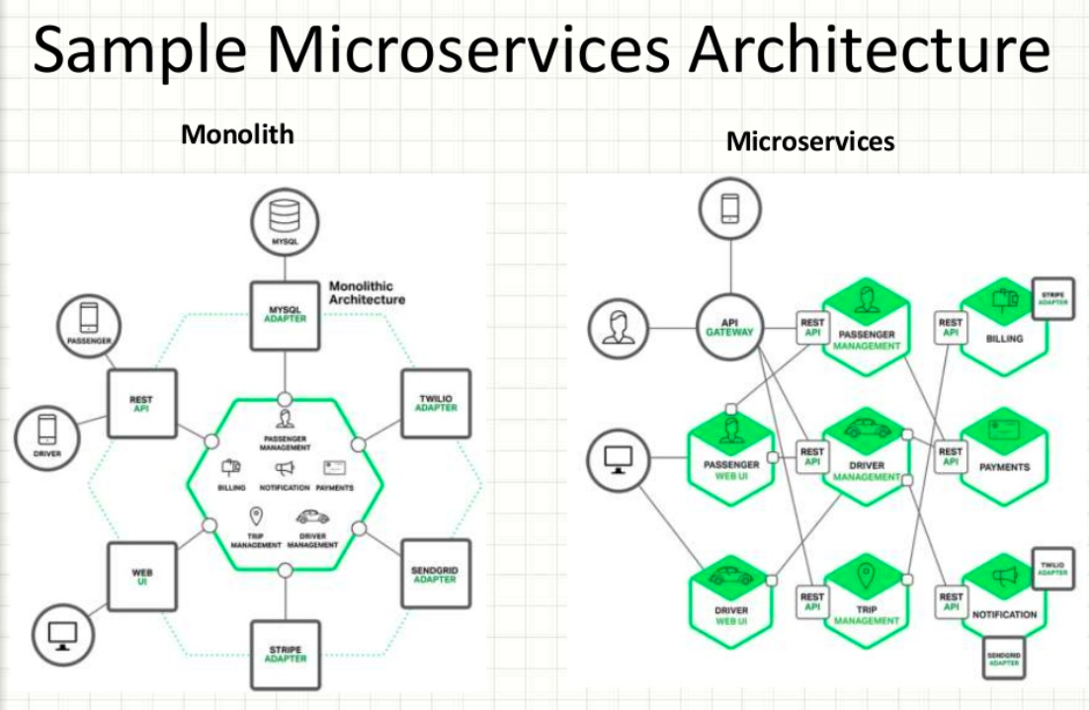
Agile Brains Consulting
18
©Agile Brains Consulting Inc. All rights reserved. Not to be reproduced without prior written consent.

Slide 19

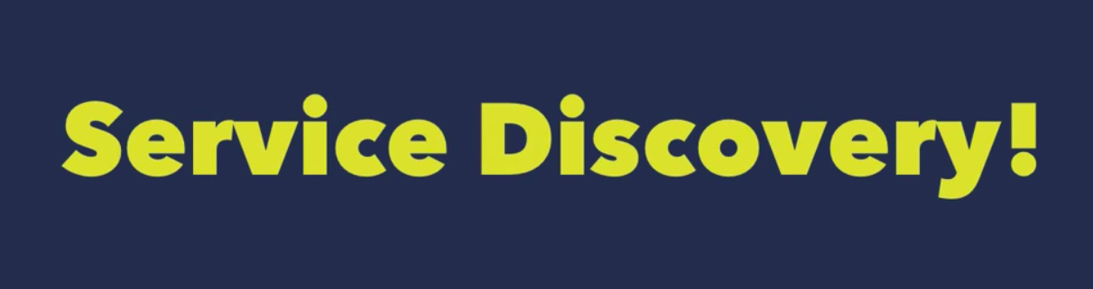
Service Discovery
Agile Brains Consulting
19
©Agile Brains Consulting Inc. All rights reserved. Not to be reproduced without prior written consent.
Notes:
https://fredjean.net/kubernetes-discovery/

Slide 20
Service Discovery
What should Service Discovery provide?
Discover services dynamically to get IP address and port details to communicate with other services
Health check: Only healthy services should participate in handling traffic
Load balancing: Traffic destined to a particular service should be dynamically load balanced
Agile Brains Consulting
20
©Agile Brains Consulting Inc. All rights reserved. Not to be reproduced without prior written consent.

Slide 21
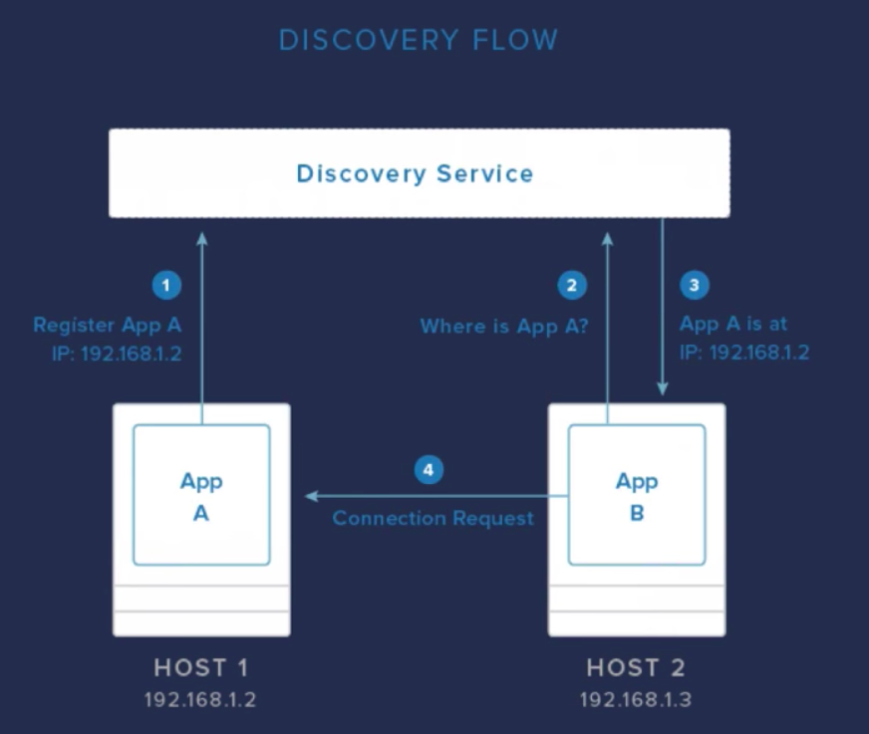
Service Discovery
Agile Brains Consulting
21
©Agile Brains Consulting Inc. All rights reserved. Not to be reproduced without prior written consent.
Notes:
https://fredjean.net/kubernetes-discovery/

Slide 22
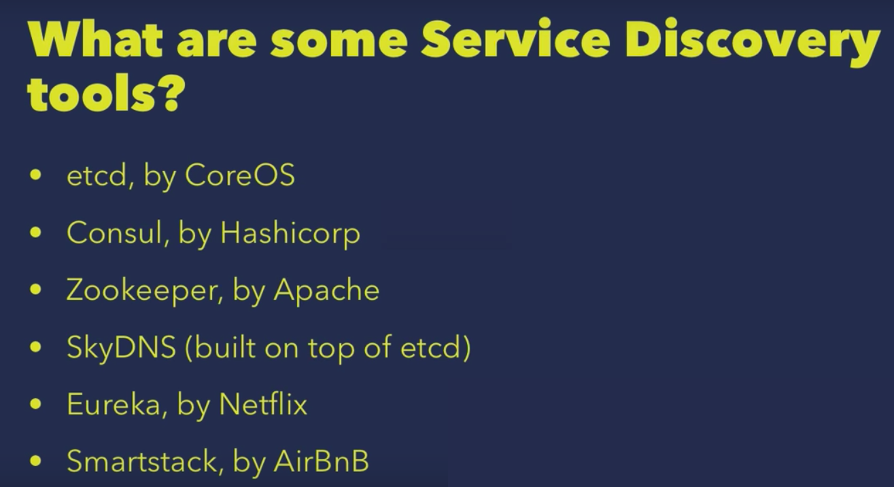
Service Discovery Tools
Agile Brains Consulting
22
©Agile Brains Consulting Inc. All rights reserved. Not to be reproduced without prior written consent.
Notes:
https://fredjean.net/kubernetes-discovery/

Slide 23
Service Discovery by etcd
Etcd can be used as KV store for service registry
Service itself can directly update etcd or a Sidekick service can be used to update etcd
Sidekick service serves as registrator
Other services can query etcd database to do the dynamic service discovery
service
service
service
service
sidekick
etcd
Agile Brains Consulting
23
©Agile Brains Consulting Inc. All rights reserved. Not to be reproduced without prior written consent.

Slide 24
Service Discovery by HashiCorp (Consul)
Consul is a distributed, highly available, datacenter-aware, service discovery and configuration system. It can be used to present services and nodes in a flexible and powerful interface that allows clients to always have an up-to-date view of the infrastructure they are a part of.
Consul provides many different features that are used to provide consistent and available information about your infrastructure. This includes service and node discovery mechanisms, a tagging system, health checks, consensus-based election routines, system-wide key/value storage, and more. By leveraging consul within your organization, you can easily build a sophisticated level of awareness into your applications and services.
Agile Brains Consulting
24
©Agile Brains Consulting Inc. All rights reserved. Not to be reproduced without prior written consent.
Notes:
https://www.digitalocean.com/community/tutorials/an-introduction-to-using-consul-a-service-discovery-system-on-ubuntu-14-04

Slide 25
Service Discovery by HashiCorp (Consul)
Has a distributed KV store for storing service database
Provides comprehensive service health checking using both built-in solutions as well as user provided custom solutions
Provides Rest based HTTP Api for external interaction
Service database can be queried using DNS
Does dynamic load balancing
Integrates well with Docker
Agile Brains Consulting
25
©Agile Brains Consulting Inc. All rights reserved. Not to be reproduced without prior written consent.
Notes:
https://www.digitalocean.com/community/tutorials/an-introduction-to-using-consul-a-service-discovery-system-on-ubuntu-14-04

Slide 26
Service Discovery – Zookeeper by Apache
Apache ZooKeeper is a distributed, open-source coordination service for distributed applications.
Allows to read, write, and observe updates to data.
Data are organized in a file system like hierarchy and replicated to all ZooKeeper servers in the ensemble (a set of ZooKeeper servers).
Operations on data are atomic and sequentially consistent.
Agile Brains Consulting
26
©Agile Brains Consulting Inc. All rights reserved. Not to be reproduced without prior written consent.

Slide 27
Kubernetes Service Discovery
Using the environment variables that use the same conventions as those created by Docker links. Using DNS to resolve the service names to the service’s IP address.
1. Environment Variables
Kubernetes injects environment variables for each service and each port exposed by the service. This makes it easy to deploy containers that use Docker links to find their dependencies.
For example, a RabbitMQ service can be located by using the RABBITMQ_SERVICE_SERVICE_HOST and RABBIT_MP_SERVICE_SERVICE_PORT variables. Other environment variables are also exposed to support this.
Agile Brains Consulting
27
©Agile Brains Consulting Inc. All rights reserved. Not to be reproduced without prior written consent.

Slide 28
Kubernetes Service Discovery
2. DNS Resolution
Kubernetes has a kube-dns addon that exposes the service’s name as a DNS entry. As a result, you can tell your application to connect to a host name. The advantage of this approach is that you do not need to do anything different than you would otherwise.
The service names are scoped within namespaces. This allows you to run different deployment of a service for each namespace (for example, one per developer or one per environments) without having to edit configuration files.
Agile Brains Consulting
28
©Agile Brains Consulting Inc. All rights reserved. Not to be reproduced without prior written consent.
Notes:
https://fredjean.net/kubernetes-discovery/

Slide 29
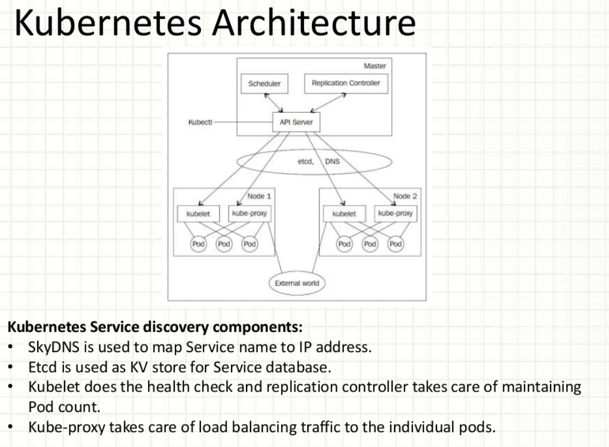
5.4 Service Discovery
Agile Brains Consulting
29
©Agile Brains Consulting Inc. All rights reserved. Not to be reproduced without prior written consent.

Slide 30
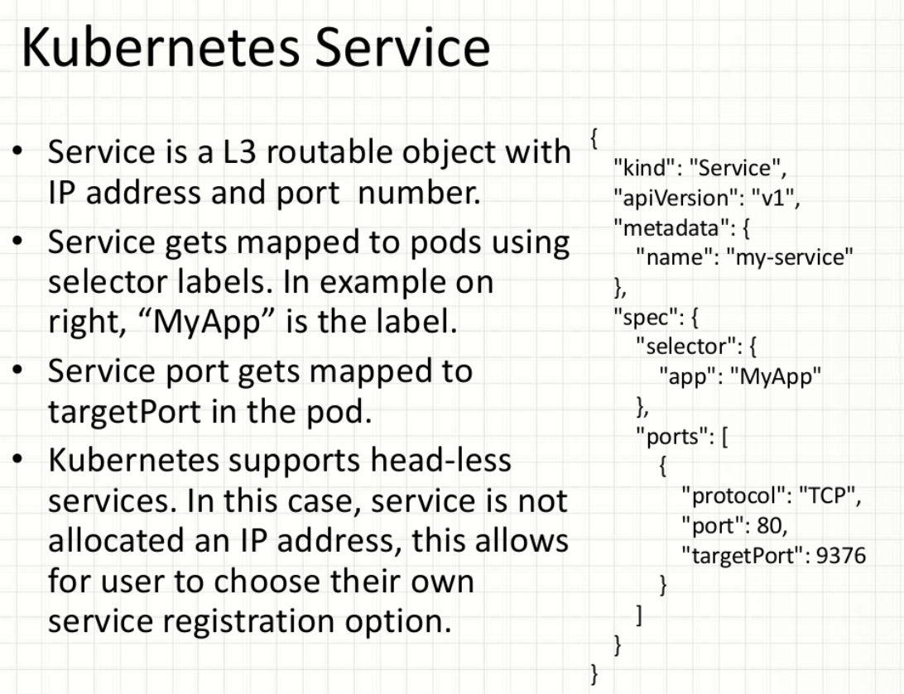
5.4 Service Discovery
Agile Brains Consulting
30
©Agile Brains Consulting Inc. All rights reserved. Not to be reproduced without prior written consent.

Slide 31
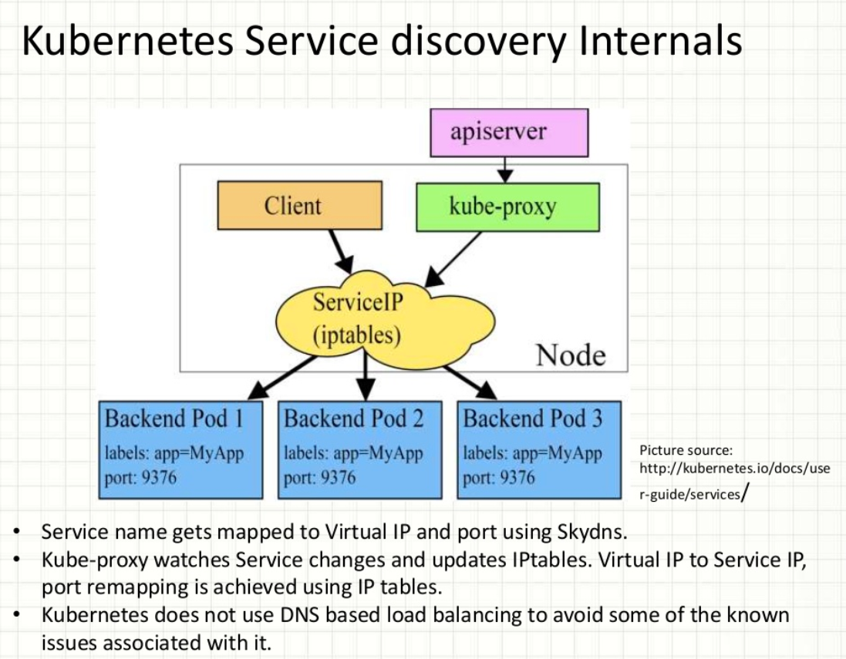
Service Discovery
Agile Brains Consulting
31
©Agile Brains Consulting Inc. All rights reserved. Not to be reproduced without prior written consent.

Slide 32
Lab: Service Discovery
https://github.com/shekhar2010us/kubernetes_teach_git/blob/master/k8s_service_discovery/service-discovery.md
Example using consul:
https://github.com/hashicorp/demo-consul-101/tree/master/k8s
Agile Brains Consulting
32
©Agile Brains Consulting Inc. All rights reserved. Not to be reproduced without prior written consent.

Slide 33
Lab: Service Discovery using Consul
- in docker, not k8s
https://github.com/shekhar2010us/kubernetes_teach_git/blob/master/plain_service_discovery_consul/service_discovery_consul.md
Agile Brains Consulting
33
©Agile Brains Consulting Inc. All rights reserved. Not to be reproduced without prior written consent.

Slide 34
CICD (Jenkins) Integration with Kubernetes
Agile Brains Consulting
34
©Agile Brains Consulting Inc. All rights reserved. Not to be reproduced without prior written consent.

Slide 35
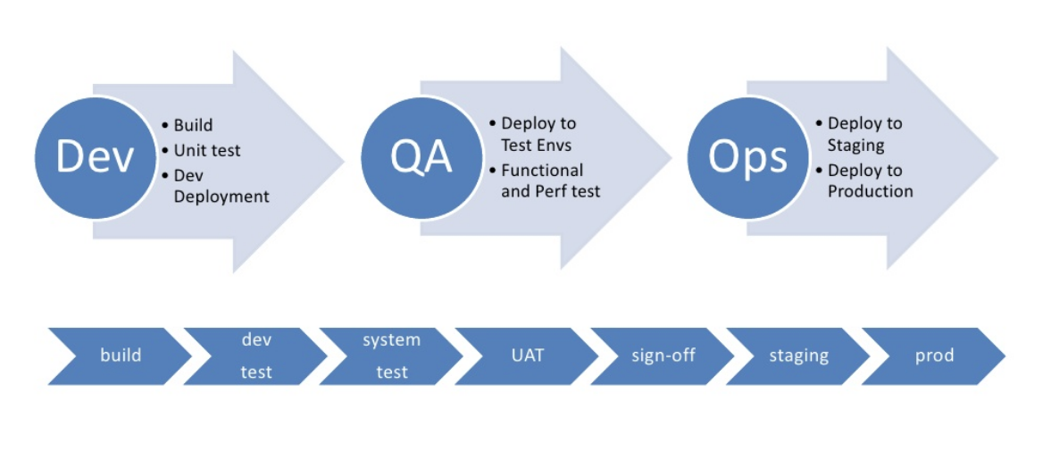
Introduction to CI/CD
What is a Pipeline
Agile Brains Consulting
35
©Agile Brains Consulting Inc. All rights reserved. Not to be reproduced without prior written consent.

Slide 36
Continuous Integration: Benefits
Reduced integration risk. More often than not, working on projects means multiple people are working on the separate tasks or parts of the code. The more people, the riskier the integration. Depending on how bad the problem really is, debugging and solving the issue can be really painful and can potentially mean a lot of changes to the code. Integrating on a daily basis or even more frequently can help reduce these kinds of problems to a minimum.
Higher code quality. Not having to worry about the problems, and focusing more on the functionality of the code results in a higher quality product.
The code in version control works. If you commit something that breaks the build, you and your team get the notice immediately and the problem is fixed before anyone else pulls the “broken” code.
Less time deploying. Deploying projects can be very tedious and time-consuming, and automating that process makes perfect sense
Agile Brains Consulting
36
©Agile Brains Consulting Inc. All rights reserved. Not to be reproduced without prior written consent.

Slide 37
Continuous Integration: Needs
VCS: The first requirement is having the version control system (VCS). There is no way around it and there shouldn’t be a way around it. VCS provides a reliable method to centralize and preserve changes made to your project over time. (Git)
CI Server: Continuous integration server (aka build server, aka CI server) is a software tool that centralizes all your CI operations and provides a reliable and stable environment for you to build your projects on.(Jenkins)
Agile Brains Consulting
37
©Agile Brains Consulting Inc. All rights reserved. Not to be reproduced without prior written consent.

Slide 38

Introduction to Jenkins
Jenkins is an open source automation server written in Java. Jenkins helps to automate the non-human part of software development process, with continuous integration and continuous delivery/continuos deployment.
Agile Brains Consulting
38
©Agile Brains Consulting Inc. All rights reserved. Not to be reproduced without prior written consent.

Slide 39
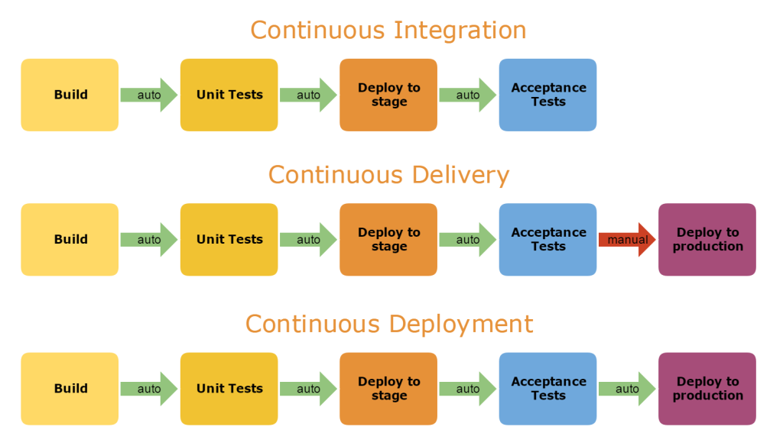
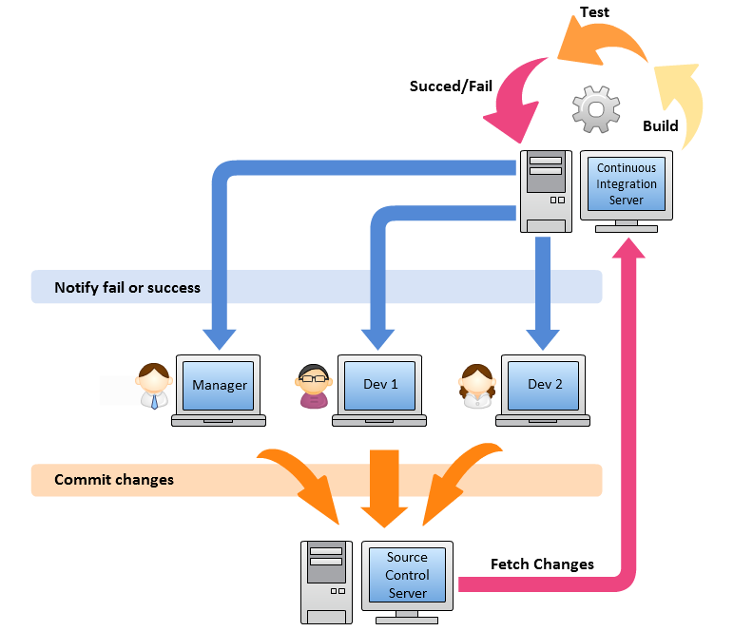
Agile Brains Consulting
39
©Agile Brains Consulting Inc. All rights reserved. Not to be reproduced without prior written consent.

Slide 40
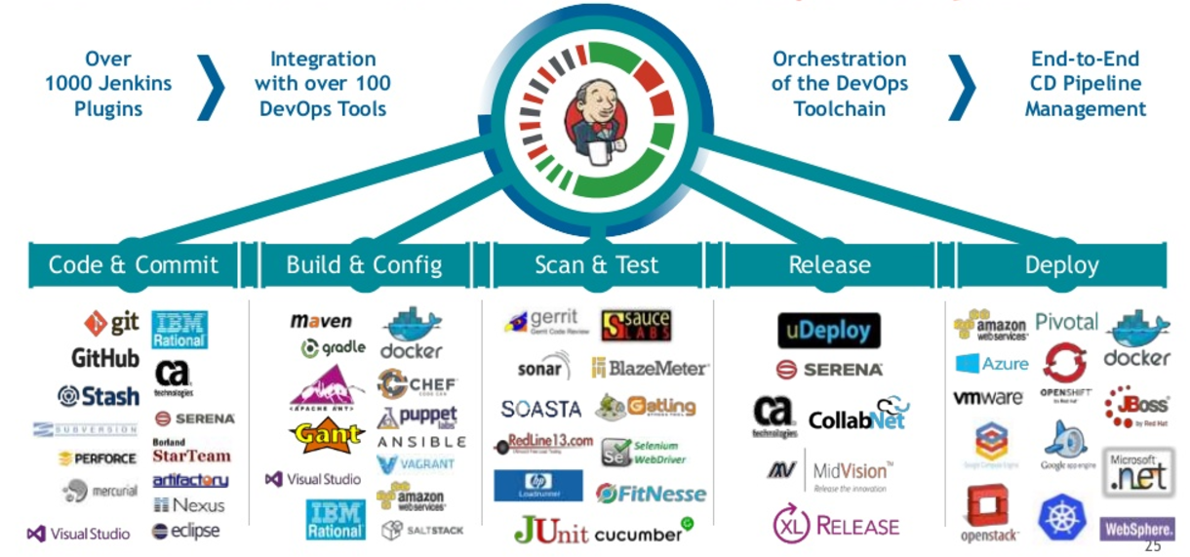
Agile Brains Consulting
40
©Agile Brains Consulting Inc. All rights reserved. Not to be reproduced without prior written consent.

Slide 41
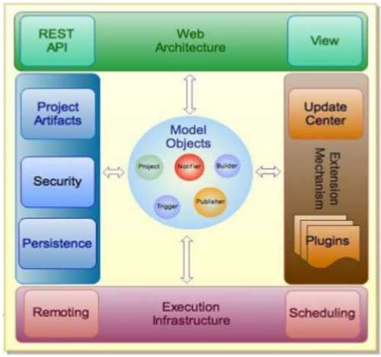
Jenkins: Introduction - Jenkins Architecture
Agile Brains Consulting
41
©Agile Brains Consulting Inc. All rights reserved. Not to be reproduced without prior written consent.

Slide 42
Deploy Jenkins in Kubernetes
https://medium.com/containerum/configuring-ci-cd-on-kubernetes-with-jenkins-89eab7234270
https://kubernetes.io/blog/2018/04/30/zero-downtime-deployment-kubernetes-jenkins/

